Slide 1
Creating and Using Consent Forms at Lindenwood University
Research & Compliance at Lindenwood Series

Slide 2
Objectives
Review LU Consent Policy
Discuss Consent Form Development
Describe Consent Conversations
Identify LU Consent Best Practices

Slide 3
“Informed consent is actually a whole mindset and process that needs to be continuously examined and improved as a whole. Its not about the form.”
A Practical Guide to Informed Consent, Temple University Health, 2009

Slide 4
Belmont Report and Consent
Autonomy
Justice
Beneficence

Slide 5
Belmont Report and Consent
Autonomy
Justice
Beneficence
Do they know its voluntary?
Am I partnering with this participant to enhance their health and wellness?
Am I communicating well to this specific demographic and social location?

Slide 6
Consent Form Regulations
45 CFR 46.116(5)
(i) Informed consent must begin with a concise and focused presentation of the key information that is most likely to assist a prospective subject or legally authorized representative in understanding the reasons why one might or might not want to participate in the research. This part of the informed consent must be organized and presented in a way that facilitates comprehension
(ii) Informed consent as a whole must present information in sufficient detail relating to the research, and must be organized and presented in a way that does not merely provide lists of isolated facts, but rather facilitates the prospective subject’s or legally authorized representative’s understanding of the reasons why one might or might not want to participate.

Slide 7
Consent Form Regulations
45 CFR 46.116(6)(b)
Basic Elements of Consent
Description of Research and Experimental Procedures
Description of Risks or Discomforts
Description of Benefits
Disclosure of Alternative Procedures (if advantageous)
Description of Confidentiality Protections
(If > min. risk) Explanation of Compensation and Treatment for Injury
Key Contact Information
Statement that participation is voluntary
Description of use of data or specimens in future research

Slide 8
LU Consent Form Policy
Use the most current Information Sheet or Consent Form Templates.
Do not alter current template language.
Obtain IRB approval prior to implementing any changes to a Consent Form or process.
Use the most recently IRB approved Information Sheet or Consent Form.
Obtain documentation of consent in compliance with requirements outlined in IRB approval.
Provide a copy of Consent Form to participant (signed when applicable).

Slide 9
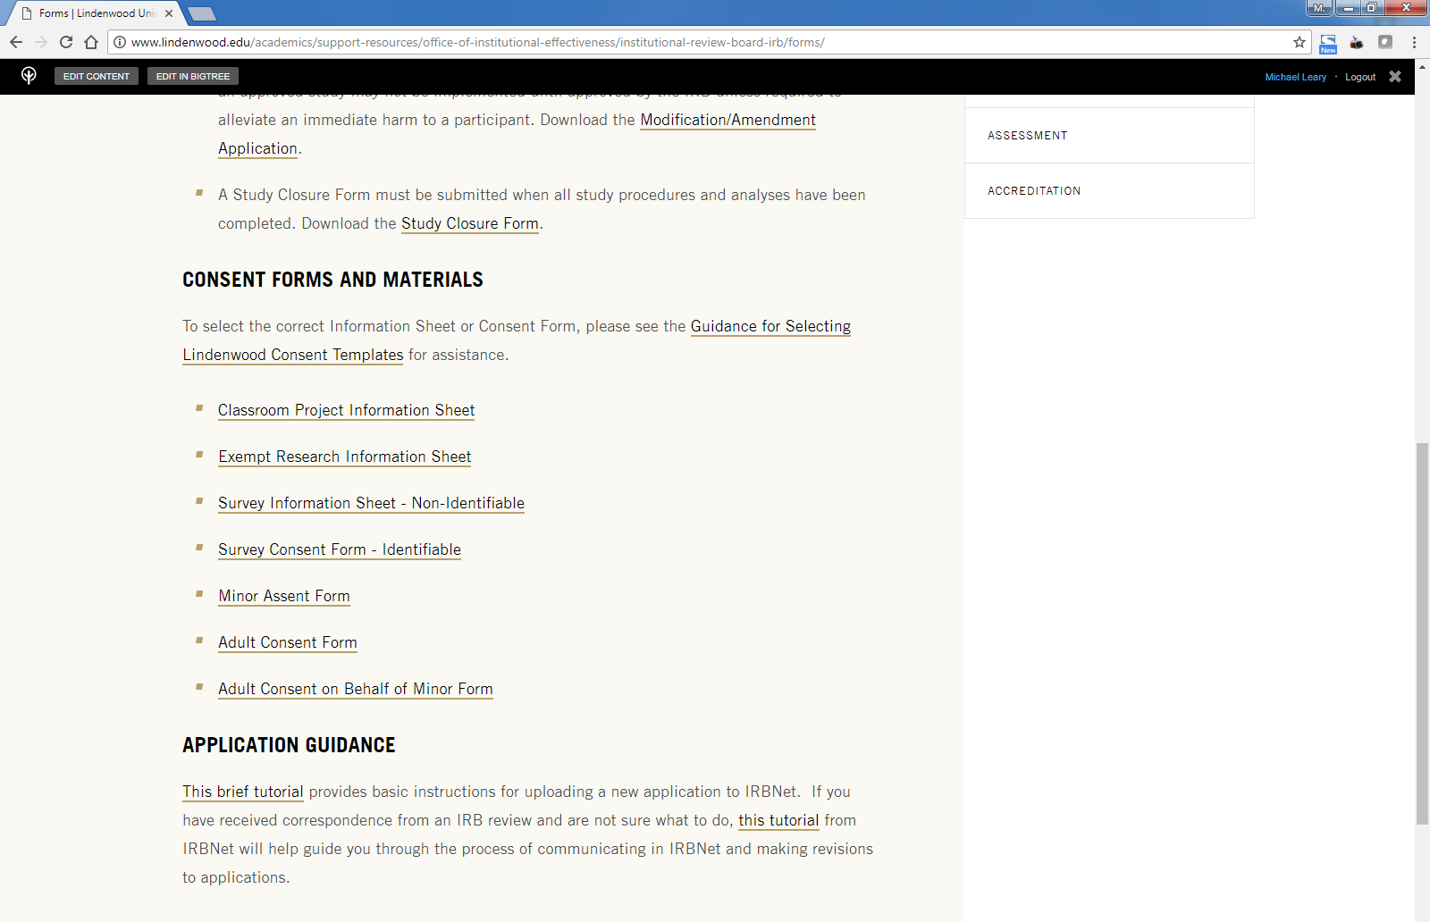
LU Consent Form Policy
Consent Form Templates

Slide 10
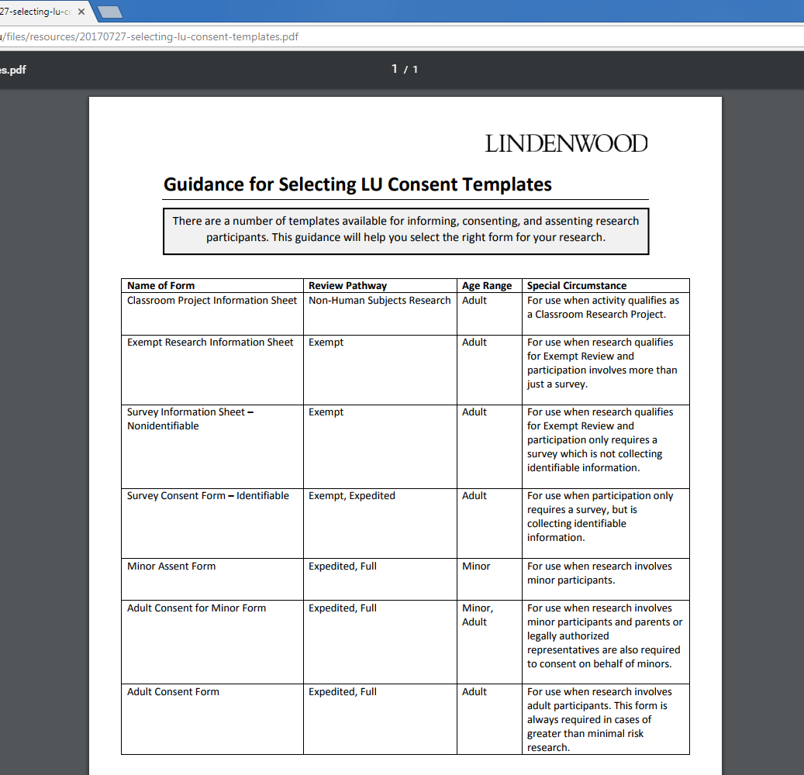
LU Consent Form Policy
Consent Form Templates
Clear guidance for selecting the proper template.

Slide 11
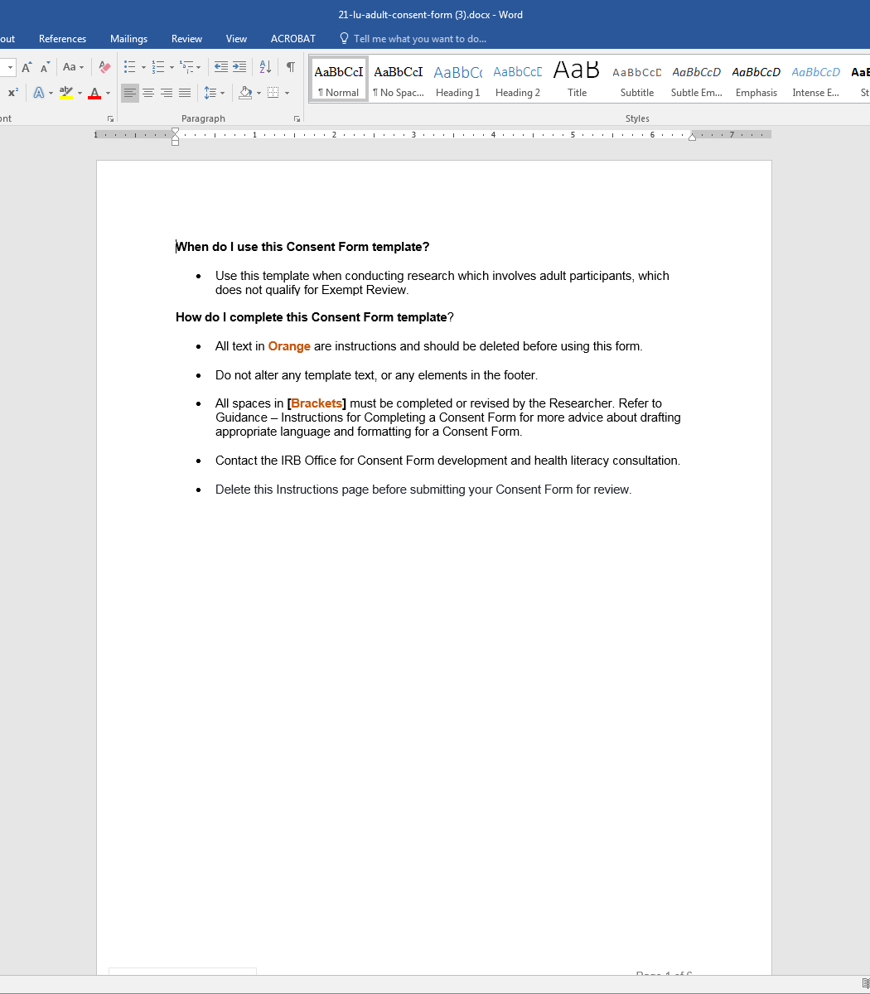
LU Consent Form Policy
Consent Form Templates
Clear instructions for using each template.

Slide 12
Developing Consent Forms
Health Literacy and Consent
“Main effects for understanding were found for processability, readability, message length, use of graphics, and verbal discussion. Consent documents with high processability, eighth-grade reading level, and graphics resulted in significantly greater gist and verbatim understanding compared with forms without these attributes.”
“These results indicate that people with low literacy skills can, with the help of pictographs, recall large amounts of medical information for significant periods of time. The impact of pictographs on symptom management and patient quality of life remains to be studied.
A. Tait, T. Voepel-Lewis, V. N. Nair, N. Narisetty, A. Fagerlin. Informing the Uninformed: Optimizing the Consent Message Using a Fractional Factorial Design. JAMA Pediatr. 2013;167(7):640–646.
PS. Houts P. Witmer J. Egeth H. Loscalzo M. Zabora JR. Using pictographs to enhance recall of spoken medical instructions. Patient Educ Couns 2001; Jun;43(3):231-42

Slide 13
Developing Consent Forms
Using Effective Design
Increase amount of white space
Divide information into “chunks” and lists
Highlight what is important with space (not bold or italicized fonts)
Reduce redundancy across sections
Use template language
Maintain consistent font and font size
Maintain consistent spacing between sections

Slide 14
Developing Consent Forms
Plenty of white space to simplify perception of information.
Simple template language.
Similar content presented in chunks.
Lists for clarity and brevity.
Space for simple, study-specific information
Boxes to highlight key information.

Slide 15
Developing Consent Forms
Using Plain Language
Use the active voice
Use short sentences
Simplify all terminology
Explain terms at first use
Spell out acronyms and initialisms at first use
Avoid abbreviations

Slide 16
Developing Consent Forms
Using Plain Language
Defining participation: “A DEXA scan will be performed...” vs. “You will have a scan of your body composition. A DEXA scan is...”
Defining medical terms: “To exhaustion” vs. “Until you are too tired to continue”
Defining process language: “Discontinue” vs. “When you would no longer like to participate”
Simpler risk language: “Adverse” vs. “harmful” or “painful”

Slide 17
Developing Consent Forms
Blocking Information with Questions:
Why is this research being conducted?
Why is this study important?
Why would I want to be in this study?
Why would I not want to be in this study?

Slide 18
Developing Consent Forms
Using Flowcharts:
Visit 1
You will complete a health questionnaire, warm up for a cycling test, and cycle for 30 minutes while wearing a mask to measure your oxygen levels.
Visit 2
You will take a nutritional supplement 1 hour before you come to the lab. You will warm up for a cycling test and cycle for 30 minutes. We will draw blood before and after the cycling test.
Visit 3
You will take a nutritional supplement 1 hour before you come to the lab. You will warm up for a cycling test and cycle for 30 minutes. We will draw blood before and after the cycling test.

Slide 19
Developing Consent Forms
Using Grids for Risks:
What is the risk? | How severe is the risk? | How often would this happen? | What might happen?
Blood Draw

Slide 20
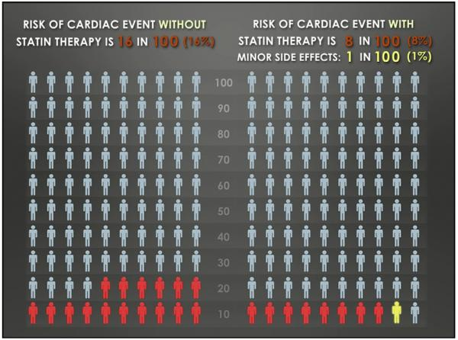
Developing Consent Forms
Using Images:
AR Tait, T Voepel-Lewis, C Brennan-Martinez, M McGonegal, R Levine. Using Animated Computer-generated Text and Graphics to Depict the Risks and Benefits of Medical Treatment. The American journal of medicine. 2012;125(11):1103-1110.

Slide 21
Developing Consent Forms
Using OptionGrid:
http://optiongrid.org/

Slide 22
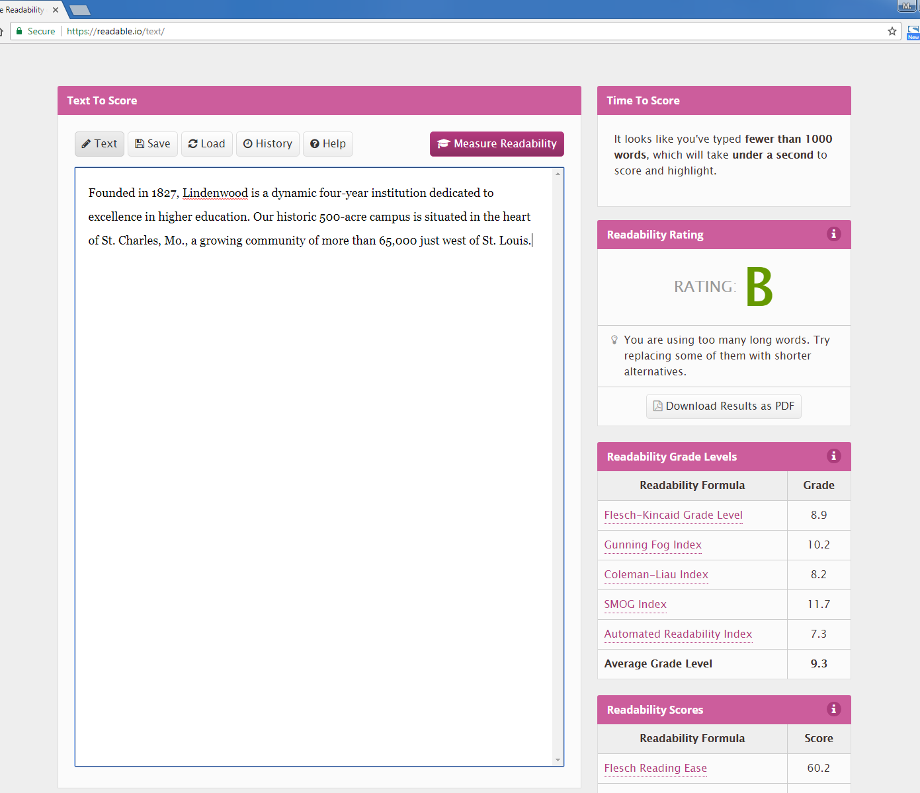
Developing Consent Forms
Using SMOG to test Reading Level
https://readable.io

Slide 23
Preparing for Consent Conversation
Using Effective Oral Communication Skills
Anticipate communication issues
Keep it slow
Do not assume comprehension
Use plain language
Use “Chunk and Check” methods
Use “Teach-Back” methods

Slide 24
Preparing for Consent Conversation
Using Teach-Back Methods
Ask questions to gauge comprehension:
“Can you tell me what the most significant risks of this research are?”
“It sounds like I did not explain the potential benefits clearly. Let’s look at that part of the consent form again.”
Be conversational:
“What do you think so far?”
“What questions do you have?”
“Do you want to think this over for a while?”

Slide 25
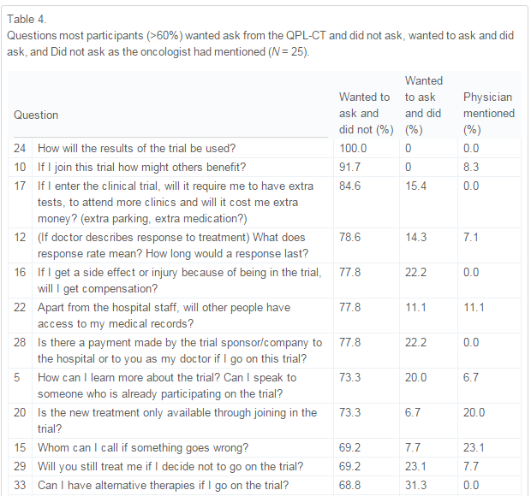
Preparing for Consent Conversation
Designing Question Prompts
Brown RF, Bylund CL, Li Y, Edgerson S, Butow P. Testing the utility of a cancer clinical trial specific Question Prompt List (QPL-CT) during oncology consultations. Patient education and counseling. 2012;88(2):311-317

Slide 26
Preparing for Consent Conversation
Thinking and Documenting Reflexively
“What have I observed (or not) that leads me to believe the child has assented/ dissented? Can I provide examples? Have I noticed any verbal/nonverbal cues?”*
Create a Note to File documenting the consent conversation and experience, to affirm positive consent was obtained.
Phelan, S. K., & Kinsella, E. A. (2013). Picture this . . . Safety, dignity, and voice—ethical research with children: Practical considerations for the reflexive researcher. Qualitative Inquiry, 19(2). pp. 81-90.

Slide 27
Documenting Consent
45 CFR 46.117(a)
“…informed consent shall be documented by the use of a written consent form approved by the IRB and signed by the subject or the subject's legally authorized representative. A copy shall be given to the person signing the form.”
45 CFR 46.117(c)
“An IRB may waive the requirement for the investigator to obtain a signed consent form for some or all subjects if it finds either:
(1) That the only record linking the subject and the research would be the consent document and the principal risk would be potential harm resulting from a breach of confidentiality. Each subject will be asked whether the subject wants documentation linking the subject with the research, and the subject's wishes will govern; or
(2) That the research presents no more than minimal risk of harm to subjects and involves no procedures for which written consent is normally required outside of the research context.”

Slide 28
Documenting Consent
All sections must be completed. Any deviation should be noted and corrected at next visit. Illegible entries should be documented in a Note to File.
The participant completes this section.
The PI or designee completes this section.
The PI or designee may complete this later, if consents are being mailed.

Slide 29
LU Consent Best Practices
Think of consent as an ongoing relationship rather than an initial contract.
Use health literacy principles when preparing a Consent Form.
Create time and space for the consent process.
Think through the consent conversation and anticipate questions and concerns.
Create a Note to File describing a completed consent process, to be stored with the signed Consent Form.

Slide 30
Resources
The IRB Office offers Health Literacy consultation upon request. Give us a call to schedule an appointment.

