Slide 1
Accessibility and Universal Design
Employee Fellow for Technology Proficiency
2020-2021
Joanna DeYoung

Slide 2
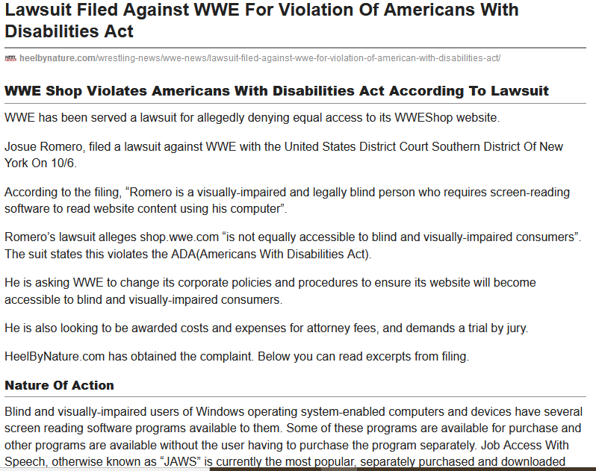
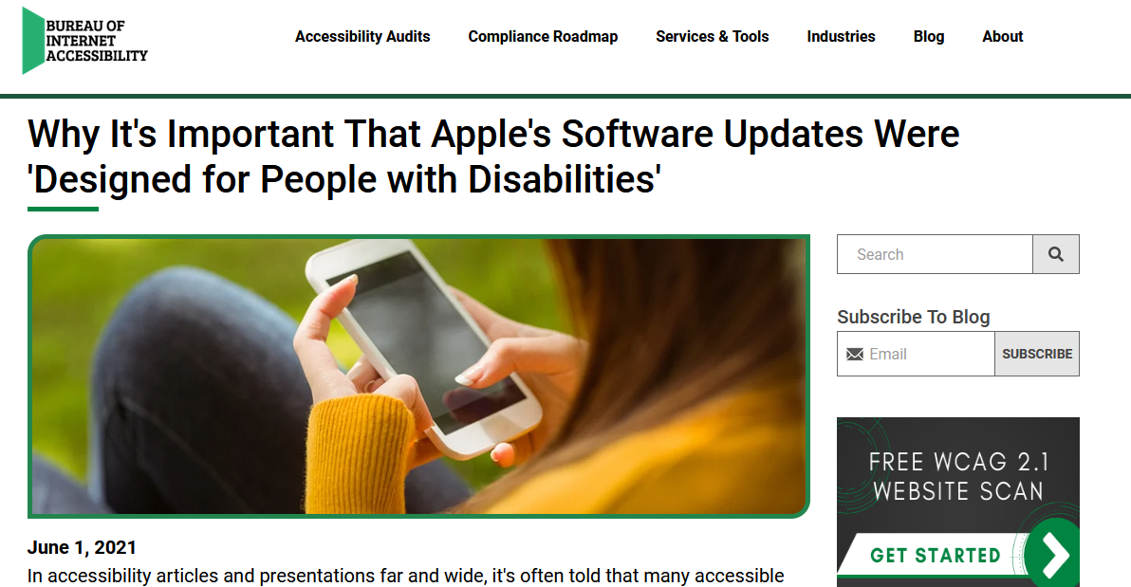
Good Design is Accessible
Universal Design is Accessible Design

Slide 3
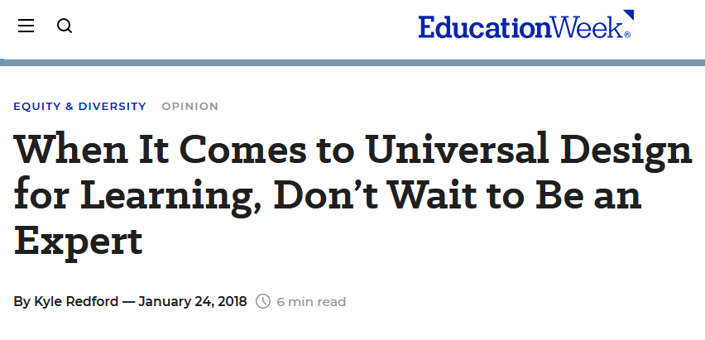
Accessible Documents and Universal Design
Fellowship Aspects
Knowledgebase survey key findings
90% of respondents asserted that Accessibility is important for physical needs and for Diversity, Equity and Inclusion.
Our best practice for Accessible documents was giving files a meaningful title or name. (87%)
Respondent demographics (as self reported): 50% Lindenwood Staff, 42% Lindenwood Faculty, 8% Lindenwood Students
Virtual Presentations on Accessibility Features of the Microsoft Products used most often (Word, Excel, PowerPoint, Outlook), PDFs and GoogleDocs.
Review best practices for the treatment of text, images, and how to check documents for Accessibility compliance.
30 sessions were offered in March and April 2021.
Accessibility reviews upon request
5 Lindenwood staff members asked me to look over meeting agendas, presentation slides and both print and web content 10 times during the academic year.

Slide 4
Thank You!
Lindenwood Learning Academy
2020-2021 Employee Fellow Cohort
Jeremy Keye
Heather Pennington
Jen Spellazza
Kristin Norwood
Jason Waack
SiteImprove
Lindenwood Accessibility Roundtable
Erica Ellard
Carlie Lee

