Slide 1
Backwards Design Teaching Task
This Teaching Task is a follow-up exercise to the Topics in Teaching and Learning video overview of Backwards Course Design. It is intended to provide faculty an opportunity to apply the three basic steps of backwards design.
On page 2, a simple template is provided as a means for capturing -- and reflecting on the alignment of -- learning goals, assessments, and activities. Draft at least one of each for a course you’ve taught before or a new one you’re designing.
On page 3, you’ll find some excerpts from a helpful resource to aid in the writing of learning goals. On page 4, there are several example learning outcomes from various disciplines.
Faculty may choose to submit their completed teaching task for feedback to the Learning Academy. Email Kristen Norwood, Director of Faculty Development at knorwood@Lindenwood.edu).

Slide 2
Simple Template for Backwards Design
Learning Goal | Learning Assessment | Learning methods/materials
What do I want students to know or be able to do? | How will they demonstrate their knowledge or ability? | What sorts of activities and materials would help them learn this such that they are able demonstrate their knowledge or ability in the ways I will ask them to do so?
Ex: One year after this course (Persuasion), I hope students will be able to apply rhetorical theories to critically evaluate persuasive communication they encounter. | Written analysis HW assignments Exam questions (short answer & essay) Persuasive artifact analysis papers | Read articles outlining and demonstrating modes of rhetorical analysis Instructor modeling of using rhetorical theory to critically evaluate persuasive artifacts In-class written analysis of artifacts followed by discussion/feedback
*Those more advanced in the practice of Backwards Design can find two more involved workbooks (from other sources) on the Learning Academy website.

Slide 3
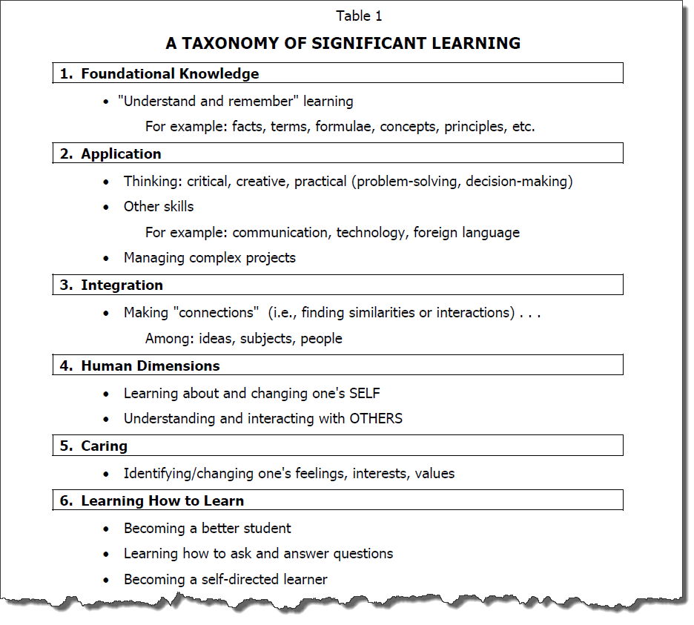
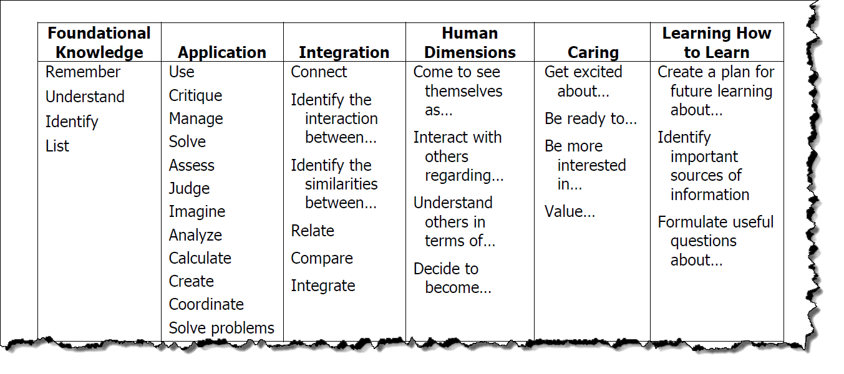
To Aid Your Thinking About Learning Goals
From: Fink, L. D. (2013). Creating significant learning experiences: An integrated approach to designing college courses. John Wiley & Sons.

Slide 4
Example Learning Outcomes
Mathematics
Apply mathematical knowledge, skill, and reasoning to solve real-world problems.
Writing
Effectively write for various audiences to explain (narrative, expository), entertain (creative), persuade (persuasive), and help others perform a task (technical).
History
Describe the chief political, social, economic and/or cultural characteristics of important ancient and pre-modern civilizations, cultures, and societies.
Sculpting
Use the formal elements and principles of 3-dimensional space (including line, shape, mass and volume, light and shade, texture, color and organizations of forms in space) to make sculptural objects.
Criminal Justice
Discuss determinate and indeterminate sentencing and the social implications of each.
Exercise Physiology
Identify equipment used to measure and evaluate various physiological aspects of human performance.

