Slide 1
Getting Fiction Short Stories Published Traditionally
The first steps

Slide 2
What we Commonly Think of with “Publishing”
Most writers dream of being published.
When we hear the word “published,” we typically think of getting novels published.
Many people associate fame with publication.
You may think:
“I’m the next J.K. Rowling!”
“Nicholas Sparks will be forgotten after my novel is released.”
“I’m just as brilliant as H.P. Lovecraft.”
“My fantasy is just as good as Lord of the Rings.”
“My story is way better than Twilight.”

Slide 3
The Rest of the Publishing Field
However, there is a publishing market for: short stories, poems, and flash fiction.
The platform for getting non-novels published is normally through literary journals and magazines.
The editors who run these literary journals and magazines usually market their journals and magazines for certain audiences and communities.
Because of the considered audience, writers who submit likeminded stories get their works published by the editors.

Slide 4
Why You Should care about Literary Journals and Magazines
You may be thinking, “I don’t want to publish a shorter work; I want to publish my super awesome novel,” but there are plenty of reasons why you should start with literary journals and magazines. Here are just 5 reasons to start with:
As a newcomer to publishing, you have no credentials. Publications give you credentials.
Starting with journals and magazines gives you practice with communicating professionally with editors.
Starting with journals and magazines gives you practice with formatting your manuscript.
Writing to be published in a journal or magazine builds audience awareness.
Being a contributor to a journal or magazine helps you to be plugged in to the writing community and market.

Slide 5
Reason One: Credentials
You may be wondering, “What do you mean by ‘credentials?’”
Publishers want to know that your writing is successful and marketable because all publishers publish work for an audience. Publishing is not cheap. For an editor to continue publishing, funds are needed.
For a publishing house, funds come from book sales.
If you are trying to publish a novel, one way an editor/publisher can know your writing is “successful and marketable” is by seeing if you have been published before.
Previous publications can come from being published in literary journals and magazines because it may be easier to be published in a literary journal or magazine.

Slide 6
Reason One: Credentials
Being published in a literary journal or magazine signals experience and skill to editors.
However, previous publications can also attract an agent.

Slide 7
Agents, or “The A- word.”
Many new writers are leery of agents, but that is normally because the writer does not understand the difference between a real agent and a fraud.
A real agent does not demand money upfront or steal your work.
A quality agent only gets paid when the writer gets paid. Because the agent only gets a small percentage of what the writers gets paid, the agent will be motivated to get the best deal possible for the writer. The more money the writer gets, the more money the agent gets.
Agents are useful in getting a novel published because an editor may be more likely to consider your work if an agent believes in the writer and is willing to represent the writer.
Some of the best publishing houses will only consider manuscripts if the writer has an agent; however, plenty of other great publishing houses do not require an agent. You should always research potential publishers.

Slide 8
Reason Two & Three: Practice
There is an art to communicating with editors. It is important to sound professional and to remember that your cover letter is the first impression the editor will have of you and your writing.
In the guidelines, the editor will typically specify what information they need from you. Some will just ask for a brief cover letter that introduces you and your piece; others will ask for a picture, a biography, your publishing history, and the details about the genre of your piece.
It is good to practice utilizing “editor lingo” and writing to editors in a respectable and concise manner. No editor wants to read any more than they have to.

Slide 9
Reason Two & Three: Practice
Submitting work to journals and magazines also allows you to become comfortable with presenting your manuscript professionally.
Not all editors want the same format, and handing in a document that is in MLA style is not enough. Most editors prefer the William Shunn format; if they do not want the William Shunn format (the William Shunn format will be explained later in the PowerPoint), they will specify what they want in the guidelines.
If your manuscript fails to meet their formatting guidelines, many editors will delete your work (without even reading it) and send you a form, or copy/paste, rejection letter. Other editors are more lenient on format, but it is still best to follow their rules.

Slide 10
Why Format Matters so Much
You may be surprised that editors can sometimes be so particular, but try to think about it from their perspective.
Editors have several stories to read in a small window of time. To help lighten the load, editors will sometimes throw out stories that do not follow the rules.
Not following the rules reflects poorly on the writer. It shows the writer is not paying attention, which makes the writer appear inconsiderate, and unprofessional.
Like a job resume, your manuscript needs to make a good impression. Following the directions is a great place to start.

Slide 11
Reason Four: Audience Awareness
As you continuously submit work to journals and magazines, you will begin to get some feedback. Not all feedback is personal, but a routine, form rejection is a good indicator that something is not working. It is best to reconsider and revise your work.
When submitting a piece, it is important to consider the editor. Editors will usually describe their preferences. However, often times, these preferences are vague. The best way to understand what the editor, your audience, is wanting is to see what has already been published.
Crafting a story for a journal/magazine helps you to think about your readers. Ask yourself, “would my story fit in with this journal/magazine?”

Slide 12
Reason Four: Audience Awareness
Some writers are uncomfortable with the idea of catering to an audience. They feel they are “selling out” if they adjust their story, but that is not a healthy perspective.
Something that is clear to you may be confusing to a reader; something that is interesting to you may not be as exciting or approachable to a reader. If you want to be published, then you have to be open to criticism and revising.
The story is still your story even if you make some changes. If you do not want to make changes, then it is likely you are not considering your audience.

Slide 13
Finding a Practice Reader/ betta reader
A great way to also be familiar with audience awareness is to have a friend or another writer read your work.
Ask your practice reader to circle anything that is unclear or confusing. It is important to choose a reader who won’t just flatter your work.
A good way to do a “flattery test” is to ask your reader to give a basic plot summary and ask some questions. If your reader is unable to answer correctly, something may need an adjustment.

Slide 14
Reason 5 Plugged in: Writing Community & Market
Writing can be a solitary activity; however, it important to know what is being written about. When reading a literary journal or magazine, you are able to see what your peers are up to.
Also, by reading a literary journal or magazine, you are showing support for your fellow writers.
The majority of writers want an audience. When you read your peers, you not only contribute to the community, but you also become familiar with what the journal or magazine’s editor is looking for.
You can also see what is being published.

Slide 15
Reason 5 Plugged in: Writing Community & Market
Like any market, there are trends in the writing market. It is important to keep track of what is “hot” to stay current.
You may discover that a story you wrote awhile ago’s style is currently trending, or you may find that your current writing style may need to be tweaked to satisfy an audience.
A lot of editors also pay attention to culture and enjoy stories that mirror certain cultural values. By staying current, you can see what subjects and areas are asking for literary exploration!

Slide 16
Finding out What Editors are Looking For
As previously mentioned, the best way to know what an editor prefers is to read what they have published.
Most editors also describe what kind of fiction they want on their “Submissions” page.
Most editors also describe what they don’t want. If an editor states that they do not accept fiction about vampires, do not send them fiction about vampires.
All editors want your short story to be formatted according to their guidelines.
All editors want your story to have correct grammar and few errors.
All editors want you to respect their word count limit. If your story is over their word count, send your story elsewhere.

Slide 17
Where to Find Literary Journals & Magazines
You may be very interested in contributing to literary journals and magazines. Perhaps you are wondering where to find them. Well, there are websites devoted to helping you find literary journals and magazines.
Here are some popular websites:
Duotrope.com (https://duotrope.com/)
TheGrinder.diabolicalplots.com (https://thegrinder.diabolicalplots.com/)
NewPages.com (https://www.newpages.com/)
Submittable.com (https://www.submittable.com/)
PW.org (https://www.pw.org/)

Slide 18
About Duotrope.com
Duotrope.com costs 5 dollars a month, but it has several amazing features and lists the most journals and magazines. Recently, Duotrope has added agents to their search engine.
Duotrope has a highly customizable search engine that allows you to find editors who are looking for what you wrote!
Duotrope lists statistics about the journal or magazine you are considering. Such statistics are: acceptance ratio, rejection ratio, payment/royalties, and average response time.
By using Duotrope, you can also get the highlights of what the editor wants and a few of the rules the editor wants you to follow on one page.
Last, you can track how many submissions you have made with the Duotrope tracker. The tracker also records how many days you have waited so you know when to query.

Slide 19
About TheGrinder.DiobolicalPlots.com
The Grinder is free and boasts a large database!
The Grinder has a customizable filter to find editors who are looking for what you wrote, much like Duotrope.com.
The Grinder offers some statistics about each magazine/journal.
The Grinder also has a dashboard to help you manage your submissions and progress.

Slide 20
About NewPages.com
Newpages.com is free!
Newpages.com has categories to narrow down your search. The categories are:
Calls for Submissions
Writing Contests
Conferences & Programs
Newpages.com does not have a customizable search engine, but it does list “classifieds.” Like Craigslist.com, it lists the most current editor calls for submissions.
You can filter through the classifieds by selecting: fiction, nonfiction, poetry, or art.
You can also do some filtering by selecting the “type.” You can select: book, chapbook, magazine, anthology, or literary site.

Slide 21
About Submittable.com
Submittable.com is free!
Submittable.com allows you to see what submitting opportunities are available.
To narrow down the search, you can select: Poetry, fiction, nonfiction, or visual art.
After making this selection, pictures of the magazine or journals’ covers will pop up. Simply click one to get a little information and a link to the magazine/journal’s website.

Slide 22
About PW.org
PW.org is free!
PW.org is designed to find many resources for a writer such as: magazines/journals, small presses, writing contests, agents, workshops, and book review outlets.
PW.org does have a search engine that allows you to narrow down your genre and subgenre, but there are not many options.
PW.org offers a submission tracker, but the webpage has many “bugs.”
PW.org is designed to keep writers in touch with the writing community.

Slide 23
Preparing your Manuscript
After you have written a story that you want to publish, you must prepare it. Here is a writer’s checklist:
Give your story some “resting” time before you revise and edit it.
Why? Because the adoration you have for your work will have time to settle, which will give you a chance to look at it with fresh eyes.
Inspect your story for grammatical errors.
Why? Nothing ruins the tone of writing more than an error and many grammatical errors will turn an editor away.
A good way to check for grammar is to read your work aloud.
Another good way to check for errors is to read your story backwards. Start at the last sentence and go up. By changing the order, your brain isn’t as likely to fill in the blanks or gloss over the problems.
Remember, there is no harm in going to the Writing Center or to a friend who is good at grammar.

Slide 24
Preparing your Manuscript
Have an honest friend or family member read your story to check to see if your content is easy to understand.
Be open to revision.
Search for some literary journals/magazines who may be interested in your story.
Read the literary journal/magazine to see what the editor is looking for and if you would be proud to have your work within their issue.
Read the editor’s guidelines to submit your story properly.
Format your story as the guidelines instruct.

Slide 25
Format
How to Format a Short Story

Slide 26
Unformatted Short Story

Slide 27
First, change the font to Times New Roman or Calibri and make it a size 12.

Slide 28
Select the text and right click. Then, click on “paragraph.”

Slide 29
Be sure your manuscript is “double spaced” and remove the extra space between your paragraphs.

Slide 30
The text should look like this:

Slide 31
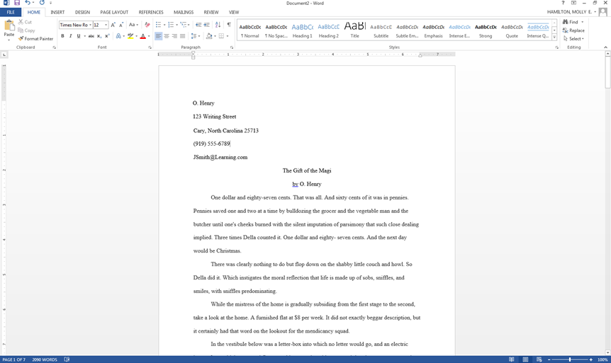
Write your contact information in the top, left corner.

Slide 32
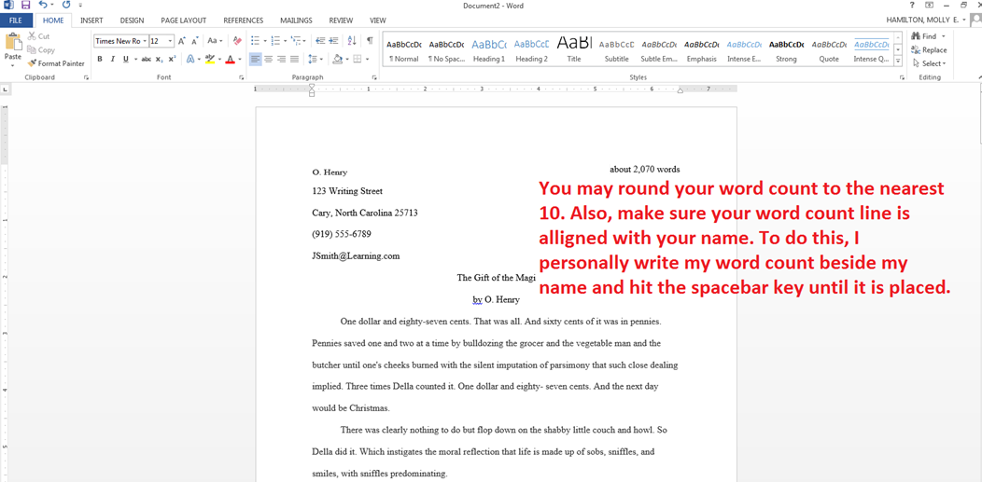
Next, write down your word count in the top, right corner.

Slide 33
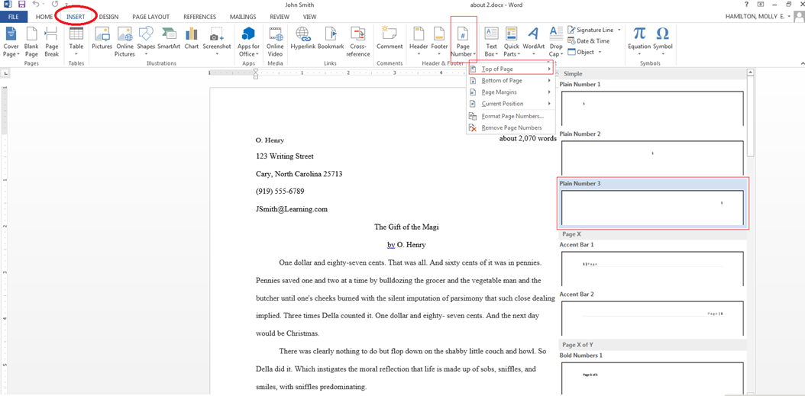
Next, insert page numbers. Have the page number be on the top right corner.

Slide 34
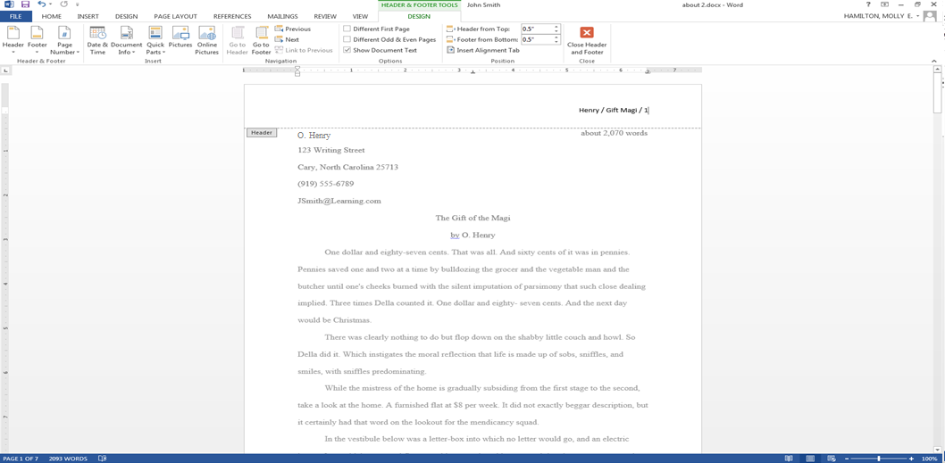
Type in your last name, the keywords of your title, and separate these sections with a /.

Slide 35
Be sure you click on the “Different First Page” button. This will keep your cover page clean.

Slide 36
Now, click on “Close Header and Footer.”

Slide 37
Move the title and your “by Your Name” to the center of the first page. Add some space between your story and your title.

Slide 38
Last Formatting Tips
Anything that is supposed to be in italics should be underlined instead.
The margins should be 1 inch all around unless the editor says otherwise.
Some writers write “End” or put a few “###” to show the end of their manuscript, but that is not a requirement.
Keep in mind that some editors have their own formatting rules. Though the William Shunn format is professional, not all editors use it. It is always important to read the editor’s guidelines.
Not all editors have the same computer software. Editors will commonly specify what kind of documents they can open. You may have to save your manuscript to a “.doc” file or “.rtf”.
Some editors do not even want an attachment. Some request that you copy and past your manuscript directly into your email!
Some editors also require that the subject of your email is formatted. Check the guidelines to see what is required. Commonly, the subject line of your email will be: “Submissions: Last Name “Title.”’

Slide 39
The Language of Guidelines
There are many important terms that editors use in their guidelines. It is essential to understand these terms to navigate through the publishing world and understand what is asked of you.
Here is a list of the most frequent terms:
Simultaneous submissions/ unsimultaneous (or exclusive) submissions
Blind submission
Multiple submissions
Reprint
First rights
Rewrite
William Shunn format

Slide 40
Simultaneous submissions/ unsimultaneous submissions
A simultaneous submission means that you may send the same story to many different literary journals and magazines at the same time.
An unsimultaneous, or exclusive, submission means that the editor requests that you do not send your story elsewhere until you receive a publication letter or a rejection letter.
Ignoring the exclusive submission policy could possibly tarnish your reputation. Many editors network together and have “sister journals/magazines.” You don’t want to be the subject of an angry email chain.
Read the editor’s guidelines to see the submission policies.

Slide 41
Blind Submission
A blind submission means that none of your contact or identifying information is on the manuscript. Not even your last name should be present! Simply format your story without contact/identifion information.
Some editors request a blind submission because they do not want to be biased.
If you accidentally leave some identifying information on the manuscript, the editor will probably disqualify your story. It is essential to read the guidelines.
Usually, you can put your contact and identifying information in your cover letter, but to be sure, read the guidelines carefully and follow the instructions.

Slide 42
Multiple Submissions
If an editor says that they accept “multiple submissions,” that means that you may send more than one piece to them. You could send them two or three short stories, many pieces of poetry, and etc...
Typically, editors ask for multiple submissions with poetry.
Most editors do not ask for multiple submissions with short stories, but it is sometimes permissible.
Always check the guidelines to see the editor’s policy on sending multiple pieces.

Slide 43
Reprint
A reprint story is a story that has already been published.
Many editors feel that literary work that appears on a personal blog, Facebook, Twitter, and other media outlets are reprints and will not accept them if they do not accept reprints.
A reprint story could also be a story that has been published by another literary journal/magazine.
Some editors are willing to publish a piece that is a reprint. Read the guidelines to see what the policy is.
If an editor is going to publish a story that has already been published by a literary journal/magazine, it is important to be sure that the previous publisher’s contract allows for republication.
Most publication contracts ask that you wait a certain amount of time before republishing your story.
Also, when republishing a story, tell the new editor where your story was published before so the proper citation can be made.

Slide 44
First Rights
If your story is going to be published, the editor will send a contract that normally requests “first rights” or First North American Serial Rights (FNASR).
First Rights simply means that the editor is allowed to publish your work one time. After this one time publication, all copyright to your piece reverts to you again.
If your story is going to be published, please read the contract carefully.
Sometimes, contract information can be found in the guidelines.

Slide 45
Rewrite
A “rewrite request” means that the editor loved your story, but requests that you make some changes in order for it to be published.
These changes could be grammatical, content, or length changes.
Rewrite requests are rare.

Slide 46
William Shunn Format
William Shunn Format is the standard format for most literary works.
For instructions on how to format your work to the William Shunn style, please see the PowerPoint section that displays this or look it up online.

Slide 47
Defining & Understanding a Cover Letter, a Biography, and a Query Letter
Some other terms that relate to literary journals, magazines, and writing in general are the following:
Cover letter
Biography
Query letter
These three terms are common parts of the submission process and will be explained.

Slide 48
The Cover Letter
A cover letter is the letter/email that the editor first sees when they open your submission.
For short stories, poetry, and flash fiction, the cover letter is normally brief.
Often times, the cover letter contains:
a greeting (if the editor lists their name, you may personally address them. If not, “Dear editor” will work)
an informational body
Genre
word count
A 1-2 sentence synopsis that does not spoil the ending
Biographical information about the author (this can vary. Check the editor’s guidelines)
a closing

Slide 49
Preparing your Cover Letter
What each editor wants in a cover letter varies. Therefore, it is essential to read the guidelines. Most editors specify what they want in a cover letter in their guidelines.
Keep in mind that the cover letter is the first impression the editor has of you as a writer. Strive to have an error free cover letter that demonstrates good writing.
Show that you have “done your homework” by following the guideline’s instructions for cover letters.
Some editors ask you to list your previous publications in your cover letter, but if you have not been published before, do not worry. Editors are aware how hard it is to be published. Having no previous publications will not disqualify your story, but for a first-time submitter, it is smart to find a literary journal or magazine that looks for unpublished writers.
If you are sending your story to more than one journal, your submission is considered a “simultaneous submission.” Some editors request to know if you have sent your story to other journals. If you did submit simultaneously and get published by another journal, write a quick email to inform other editors that your story has been chosen elsewhere.
Many literary journals and magazines ask for a short biography about the author. Some editors want the bio to be in the cover letter; some editors want the bio at the end of the submitted piece. See the guidelines to find out where to place it.

Slide 50
Cover Letter Example
Dear editor,
Thank you for your time and consideration. Enclosed is the short story "Naked Vanity" (5,769 words). The story seeks to solve the mystery of the true power of language.
The setting displays a futuristic world where technology has removed the last of human dignity. Cameras are embedded in every human's forehead to record everyone's daily lives, and bar-codes are imprinted on every wrist for a curious person's scanning convenience. Essentially, anyone can scan a bar-code and watch a person's life story. The villain of the tale uses this power to manipulate the language of his victim. Thank you again,
Molly Molly E. Hamilton is a writer who enjoys creating stories that allow readers to discover new creatures and new explanations for the ordinary. Molly, as well as her characters, wish to entertain all who are bored and cheer all who are lonely. Her work has appeared in Linguistic Erosion, Inwood Indiana, and in the Phantom Kangaroo.

Slide 51
Cover Letter Example
Hello,
Thank you for your time and consideration. Enclosed is the short story “Naked Vanity.” The story, which is 5,770 words, explores the essence of language and the power it really has. The setting displays a futuristic world where technology has removed the last of human dignity.
This story has been sent to other journals. If it is accepted elsewhere, I will be sure to inform you.
Thank you again,
Molly Molly E. Hamilton is a student at Lindenwood University. When she is not working or attending classes, she can be found spoiling a rather large rabbit and a small dog. You can find more of Molly’s writing in Phantom Kangaroo, Scarlet Leaf Review, and in the anthology Harvest Time, edited by Glenn Lyvers.

Slide 52
Cover Letter Example
Dear Mrs. Donald,
Thank you for your time and consideration. Attached is my short fantasy story "The Maiden's Tears in the Lake." It is 2,710 words long. The story is a mash up of Swan Lake and a classic haunted woods tale.
Enjoy!
Molly

Slide 53
The Biography
The biography, or bio, is simply the “about the author” segment.
Many editors will ask for a brief biography about you to publish with your story.
You are responsible for writing your biography. Here are few things to keep in mind:
Almost all biographies are in third person.
Most biographies range from 50-200 words. Always check with the editor’s guidelines to see how long your biography should be.
The information included in your biography is up to you. However, many writers list where else they have been published.
If you have a website (such as a blog, Facebook page, or actual site), you should consider adding where to find it in your bio.
Keep your bio short and creditable. Causally mention what qualifies you as a writer. (Qualifiers can be education, writing awards, and previous publications.)
Try not to sound boastful.

Slide 54
Example of a Biography
Molly E. Hamilton is a writer who enjoys creating stories that allow readers to discover new creatures and new explanations for the ordinary. Molly, as well as her characters, wish to entertain all who are bored and cheer all who are lonely. Her work has appeared in Linguistic Erosion, Inwood Indiana, and in the Phantom Kangaroo.

Slide 55
Example of a Biography
Molly E. Hamilton is a graduate student at Lindenwood University. When she is not working or attending classes to get an MFA in writing, she can be found spoiling a rather large rabbit and a little dog. You can find more of Molly’s writing in Phantom Kangaroo, Scarlet Leaf Review, and in the anthology Harvest Time, edited by Glenn Lyvers.

Slide 56
The Query Letter
First, there are two kinds of query letters:
The “sales pitch” you make to an editor or agent regarding a longer work. This kind of letter is made to prompt the editor or agent to request you to send your work.
The “follow up” letter you send that inquires about the status of your story after waiting beyond the estimated time.
We will be discussing the second definition.

Slide 57
The Query Letter
Query letters (second definition) are respectful and short letters. Even if you may be irritated with waiting, you must sound professional.
For a query letter: greet the editor, say who you are, say what your story title is, specify when you submitted, and wrap up your letter with a polite closing.
Be sure to check the guidelines for any querying rules!

Slide 58
Example of a Query Letter
Dear editor,
My name is Molly Hamilton, and I am writing in regards of a submission I made on May fifth, 2015. The story I submitted was titled “The Upside-down J,” and I have not yet received a response from you.
Please let me know if I need to resend it to you or if it is still being considered for publication.
Thank you,
Molly

Slide 59
Waiting
Generally, editors will have an estimate of how long you will have to wait for a response.
Editors can take weeks or even months to respond to your story.
Editors generally list when they are open to take submissions. You may have to wait for their reading period to open before you can submit your work.
Some editors may never respond.
If the editor has gone beyond the response time, check the guidelines to see how long you must wait before you send a follow up/query letter.

Slide 60
Following the Editor’s Rules
Editors write their guidelines for a purpose.
Editors have hundreds and hundreds of submissions to read. To narrow down their workload, writers who disobey their rules usually have their stories deleted and unread.
Read all of the guidelines carefully and follow the instructions and respect what the editor considers acceptable and unacceptable.
By following the guidelines, you show you are good to work with and professional.
If you are confused about an editor’s rules, you can normally email them your question!
If an editor does not accept “simultaneous submissions” but you send your story to them and others, you are at high risk of not getting your story published by them.
If you spite an editor, other editors may find out. Many journals have “sister journals” and many editors network together.

Slide 61
How to Submit to Your Work to the Editor
In the guidelines, editors will tell you how to submit.
Most commonly, writers submit their work through email (make sure you email address is respectable!), a form on the journal/magazine’s website, or the website Submittable.
Submittlable.com is free for writers to make an account and allows the writer to check for status updates.
Writers can watch their work go from “Received”, “Pending”, “Accepted”, or “Declined.”
Writers can also “withdraw” their work using Submittable.
Writers should withdraw their work if it has been published first by another publisher.
Submittable can also be a communication platform for the writer and editor/publisher.

Slide 62
Perseverance
The writing world is filled with lots of competition. Your story could be competing with a 1,000 other stories or more.
Some editors will have a theme for their literary journal/magazine, and it is possible that another author’s story was a better fit for the theme.
It is also important to remember that the editor is a person with biases. Your story could be published because it reminded the editor of their childhood, or it could be rejected for featuring a cat, which the editor is deathly allergic to.
The more your submit, the better your chances of publication are.
Essentially, to get published, you must have lots of perseverance.

Slide 63
Questions
If you have any questions or concerns, please contact Molly Hamilton at MHamilton1@Lindenwood.edu.

Slide 64
Further Resources: Best Literary Magazines as of 2018
The New Yorker https://www.newyorker.com/about/contact
Glimmer Train http://www.glimmertrain.com/pages/writing_guidelines.php
The New England Review http://www.nereview.com/ner-submissions/
Harper’s Magazine https://harpers.org/submissions/
Threepenny Review https://www.threepennyreview.com/submissions.html
Michigan Quarterly http://www.michiganquarterlyreview.com/submit/
The Gettysburg Review http://www.gettysburgreview.com/submissions/
The Missouri Review https://www.missourireview.com/submissions/
Chicago Review http://chicagoreview.org/about/submissions/
Black Warrior http://bwr.ua.edu/online-edition/call-online-submissions/

Slide 65
Further Resources: Best Science Fiction and Fantasy Magazines as of 2018
Analog http://www.analogsf.com/contact-us/writers-guidelines/
Asimov's Science Fiction http://www.asimovs.com/contact-us/writers-guidelines/_
Fantasy and Science Fiction Magazine https://www.sfsite.com/fsf/glines.htm
Lightspeed https://johnjosephadams.moksha.io/publication/lightspeed
Clarkesworld http://clarkesworldmagazine.com/submissions_tracker/
Strange Horizons http://strangehorizons.com/submit/fiction-submission-guidelines/
Beneath Ceaseless Skies http://www.beneath-ceaseless-skies.com/submissions/
Apex https://www.apex-magazine.com/submission-guidelines/
Three-Lobed Burning Eye http://www.3lobedmag.com/submissions.html
Shimmer https://www.shimmerzine.com/guidelines/fiction-guidelines/
Space and Time http://www.spaceandtimemagazine.com/tag/submissions/

Slide 66
Further Resources: New Writer Friendly Magazines
The Scarlet Leaf Review https://www.scarletleafreview.com/submissions.html
Arrow Rock http://www.lindenwood.edu/academics/beyond-the-classroom/publications/arrow-rock/
Bewildering Stories http://www.bewilderingstories.com/submissions.html
Fiction on the Web https://www.fictionontheweb.co.uk/p/submissions.html
The Drabble http://www.thedrabble.com/
Literally Stories https://literallystories2014.com/submission-guidelines/

Slide 67
Further Resources: Magazines that Respond quickly
Riggwelter (0.5 days) Eunoia Review (0.9 days) The Dark Magazine (1.5 days) The Penn Review (1.8 days) Metaphorosis (2.0 days)
Jellyfish Review (2.0 days) Clarkesworld Magazine (3.1 days) The Threepenny Review (3.3 days) Star 82 Review (*82) (3.9 days) Ghost Parachute (4.2 days) Fantasy & Science Fiction (F&SF) (4.9 days)
Gone Lawn (5.0 days) After the Pause (5.3 days) OCCULUM (6.4 days)
MoonPark Review (6.7 days) Asymmetry (7.1 days)
Eastern Iowa Review (7.3 days)
Five on the Fifth (7.4 days) Shimmer (7.6 days)

