Slide 1
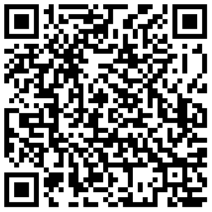
Missouri Boys State College Credit | 2023-2024
Steps to Enroll
1. Submit Your Application & Registration Form Online
Complete and submit the Lindenwood Missouri Boys and Girls State application for admission and registration by the posted deadline. Please be sure to use your personal email address when creating your profile.
2. Submit Payment
Tuition for this special college credit opportunity is $100 per credit hour. This rate is a significant savings compared to Lindenwood University’s regular undergraduate tuition rate. Total tuition cost for Option I is $200 and $300 for Option II (Credit card processing fees may apply.). Payment is due at the time of registration. Please follow the prompts when submitting your application. Your registration is not complete until payment is submitted.
3. Obtain Parent/Guardian Approval
After submitting your application, your parent or guardian will be sent an email within 24 hours which allows them to electronically approve your registration. Parent approval is due by the close of registration. Please enter correct email addresses on your application or we may not be able to process your application, and you will not receive credit. Registration is not complete until the student registers, a parent approves the registration, and the student's high school verifies the student's enrollment. Our office will contact school counselors for enrollment verification. Please include your high school counselor’s name and contact information on the application to prevent delays in processing.
FERPA
The Early College Academy adheres to all FERPA policies. When a student turns 18 years old or enters a postsecondary institution at any age, all rights afforded to you as a parent under FERPA transfer to the student. If the student would like to give LU permission to talk with someone else about their academic and financial records, they will need to complete a FERPA waiver.
TRANSFERABILITY
Participants should be aware that the receiving institution determines how a college credit class transfers. All participants should verify transferability of credit by contacting the receiving institution prior to registration.
CONTACT INFORMATION
(636) 949-4918
boysandgirlsstate@lindenwood.edu
209 S. Kingshighway
St. Charles, MO 63301
DEADLINES
Option I
August 4, 2023 – Registration Opens
Sept. 1, 2023 – Registration & Payment Due
Oct. 1, 2023 – Transcripts Available
Option II
August 4, 2023 – Registration Opens
Nov. 1, 2023 – Registration & Payment Due
Dec. 25, 2023 – Students receive access to
online course materials through Canvas.
Jan. 8, 2024 – Online course begins
March 3, 2024 – Online course ends
April 1, 2024 – Transcripts Available
WITHDRAWING FROM COURSES
Students may not withdraw from Option I once registration is complete. Students selecting Option II may withdraw from the course any time before February 11. If a student withdraws from the course, they will receive a 'W' grade. The 'W' is not factored into the student's GPA, but it will become a part of the student's official transcript and may impact financial aid eligibility. Tuition payment is non-refundable. Email: earlycollegestart@lindenwood.edu
to request a withdrawal.
APPLY TODAY

